Slide 1

E-COMMERCE WEBSITE
Nandyala
dasaratha reddy
21691A0528

Slide 2

CONTENTS
Project Overview
Introduction
Components Used
Output
Conclusion

Slide 3
PROJECT OVERVIEW
Establish a strong online footwear presence
Offer diverse, high-quality shoes at competitive prices
Provide a seamless, user-friendly online shopping experience
Cultivate customer loyalty through exceptional service
Achieve sustainable growth and profitability
Target a broad audience, including fashion enthusiasts, sports enthusiasts, families, and style-seekers
Encompass website design, product catalog management, shopping cart functionality, order
management and marketing
Deliver a functional e-commerce website, comprehensive product catalog, secure shopping cart system, and optimized website content
Estimated timeline of 12 weeks, divided into planning, development, and testing
Measure success by website traffic, sales growth, customer satisfaction, and search engine ranking

Slide 4
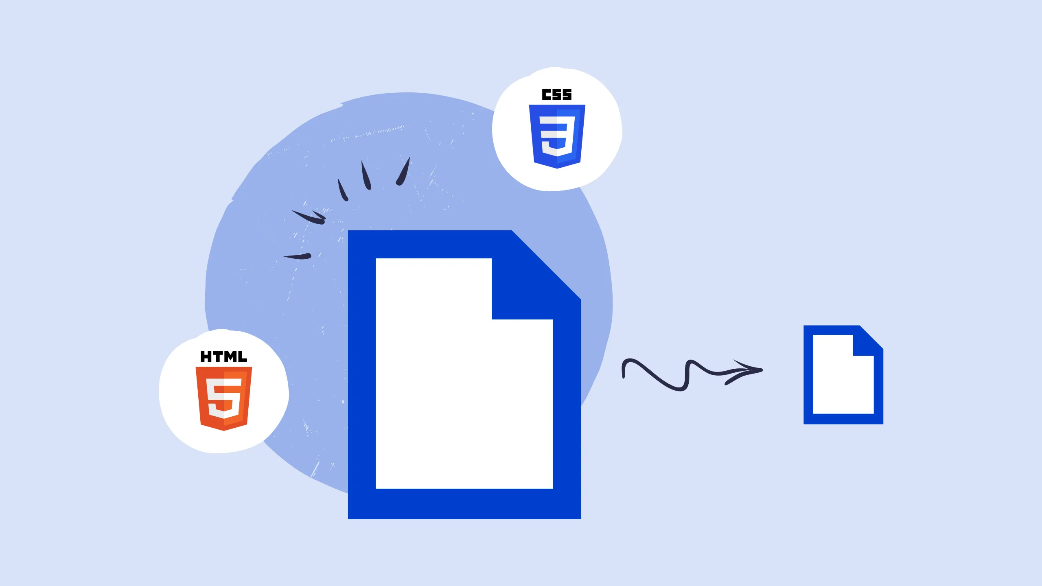

INTRODUCTION
The landscape of e-commerce continues to evolve, placing increased emphasis on front-end development to create compelling, user-friendly, and efficient online platforms. This abstract focuses on the significance of front-end development in the context of e-commerce websites, highlighting its pivotal role in shaping user experience, optimizing functionality, and driving engagement.
Front-end development in e-commerce is a multifaceted discipline that involves the creation and implementation of user interfaces, interactivity, and the overall visual appeal of online stores. It encompasses the utilization of various technologies, including HTML, CSS, and JavaScript, along with frameworks and libraries such as React, Angular, or Vue.js, to craft seamless, responsive, and intuitive designs.

Slide 5
Components used
HTML
CSS
JAVA SCRIPT

Slide 6
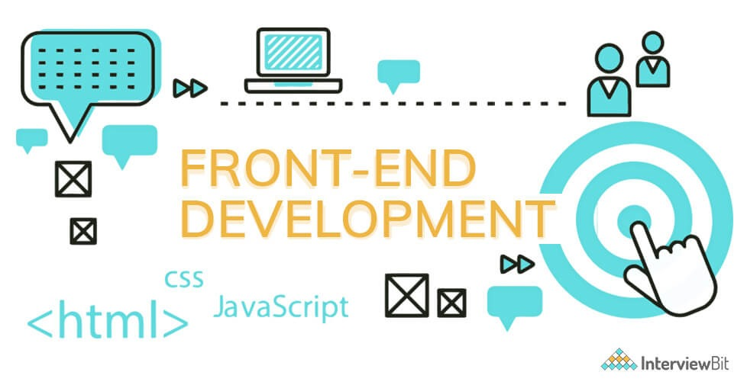
What is Front-End Development?
Front-end development, also known as client-side development, involves creating the user interface and user experience of a website.
It includes HTML, CSS, and JavaScript.
Front-end developers work on the design and functionality of a website that users interact with directly.

Slide 7

HTML
HTML stands for HyperText Markup Language.
HTML is the standard markup language for creating web pages.
HTML codes are written in plain text and can be inserted into a document using a text editor.
HTML codes tell a web browser how to display a web page.
HTML can also be used to embed multimedia content, such as videos and audio.
HTML is a relatively easy language to learn.
There are many resources available to help you learn HTML.
HTML is a versatile and powerful language that can be used to create a wide variety of web pages.

Slide 8

CSS
CSS stands for Cascading Style Sheets
CSS can be applied inline, internally, or externally.
CSS selectors target specific HTML elements or groups.
CSS properties define styles like color, fonts, and margins.
CSS values can be keywords, numbers, or units like pixels or percentages.
CSS can create responsive layouts that adapt to different screens.
CSS frameworks like Bootstrap provide pre-built components.
CSS is a powerful tool for creating beautiful and accessible web pages.

Slide 9

Java Script
Dynamic, interpreted programming language: JavaScript is a flexible language that doesn't require compilation and adapts to changing types at runtime.
Object-oriented with first-class functions: JavaScript's prototype-based inheritance and first-class functions enable powerful and versatile programming constructs.
Multi-paradigm support: JavaScript embraces event-driven, functional, and imperative programming paradigms, catering to diverse coding styles.
Extensive standard library: JavaScript's rich standard library provides comprehensive APIs for manipulating text, dates, regular expressions, data structures, and the DOM.
Core web technology with expanding applications: JavaScript is the cornerstone of interactive web pages and web applications, and its reach extends to server-side scripting, IoT development, and more.

Slide 10

OUTPUT

Slide 11
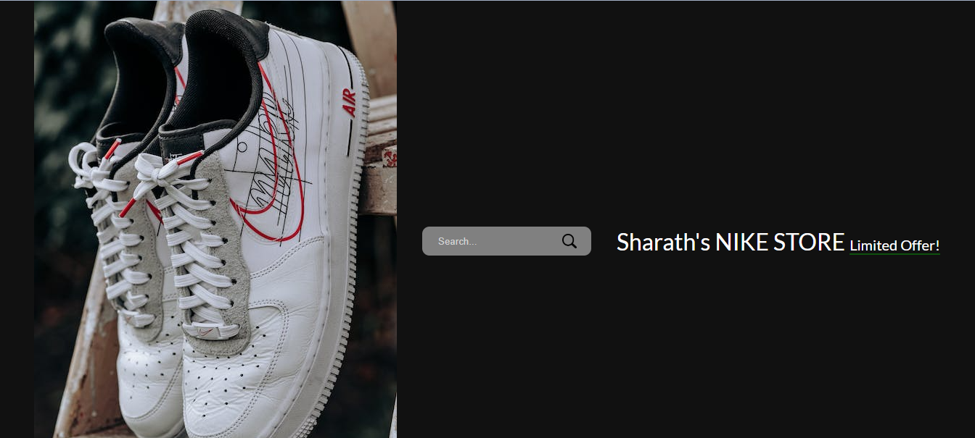

Output
Home page
Home page

Slide 12
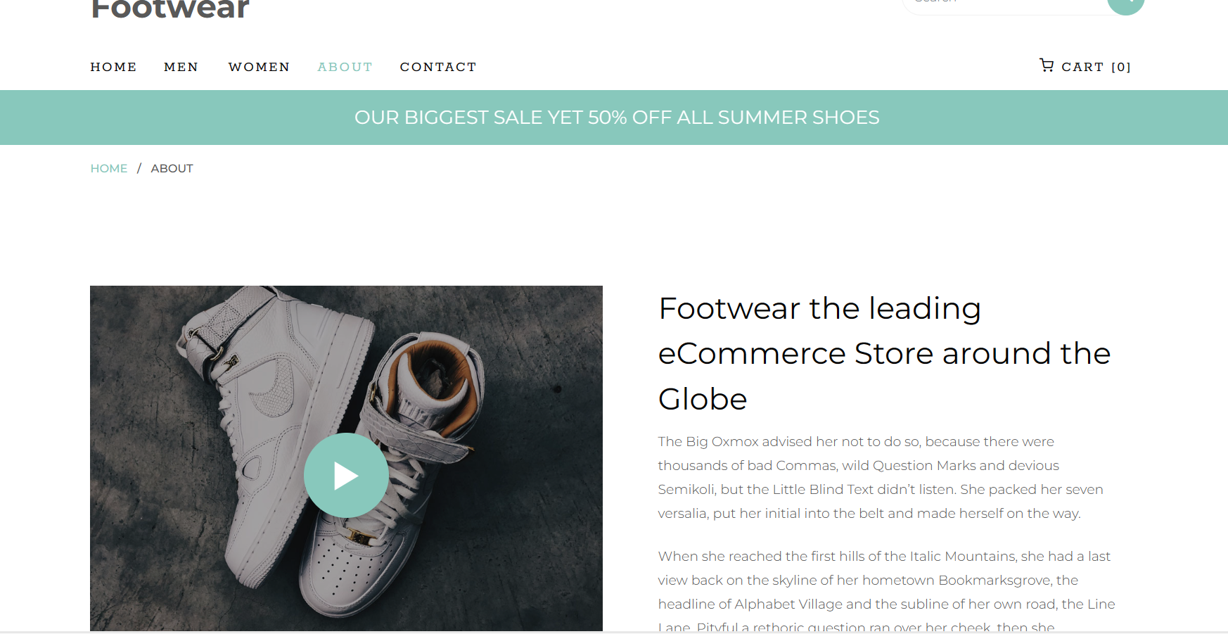
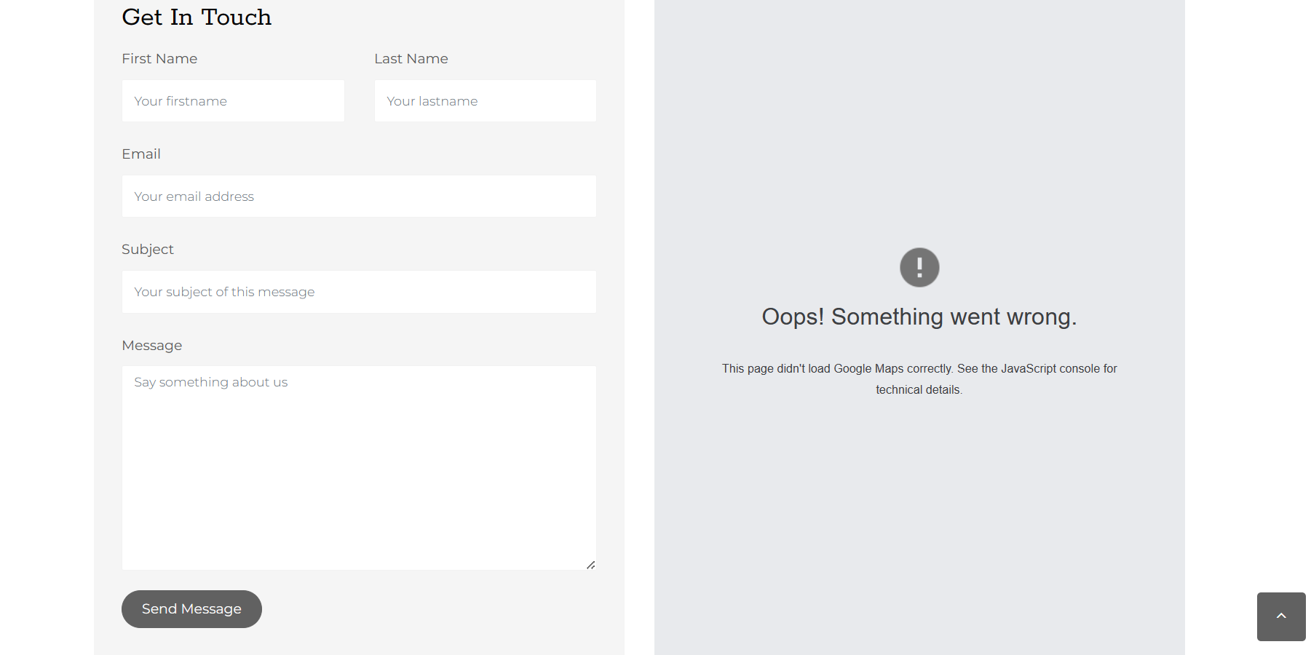
About shoe mart
Feedback

Slide 13
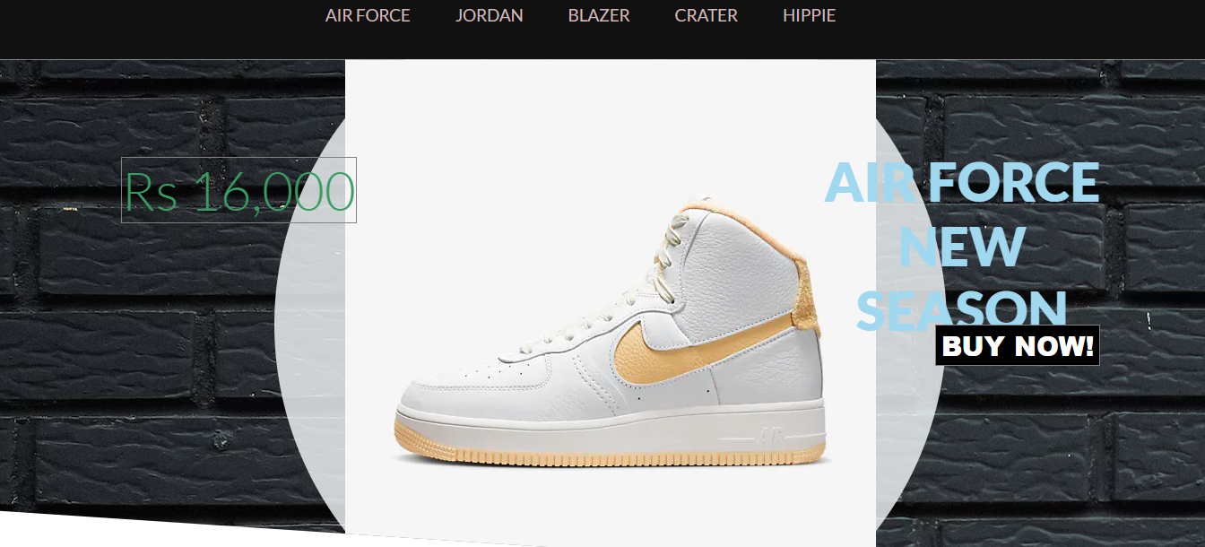
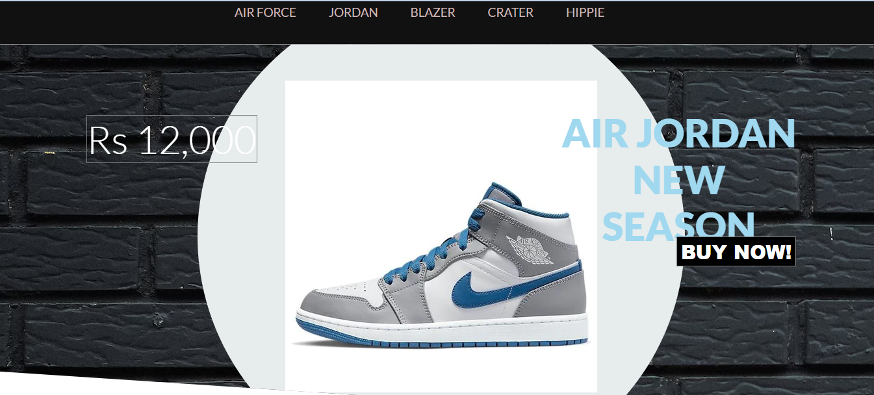
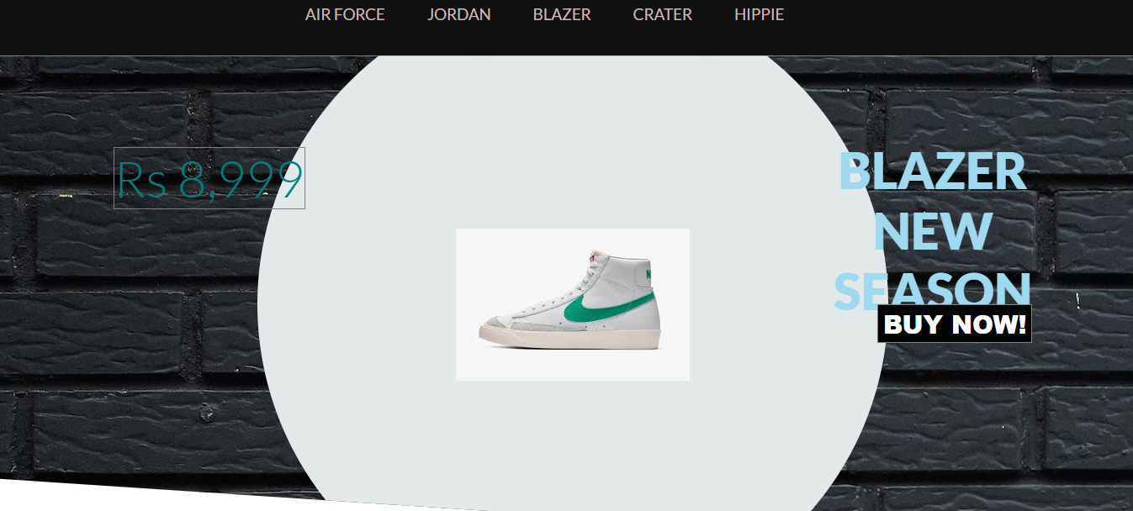
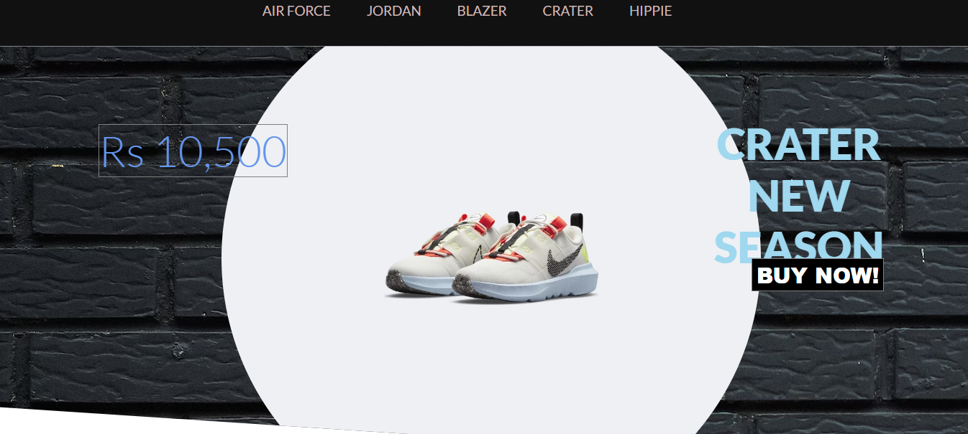
Types of Shoes

Slide 14
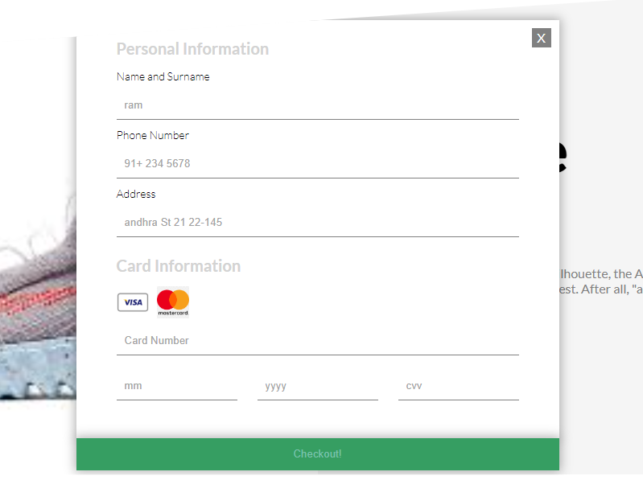
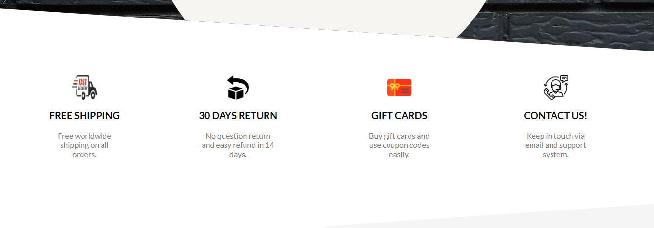
Personal & Payment Details
Features that are available in our website

Slide 15

Conclusion
The Shoe Mart e-commerce project has successfully implemented a user-friendly and functional online shoe store. The project has achieved its objectives of providing a seamless shopping experience for customers, enhancing brand awareness, and expanding the company's reach. The project has demonstrated the effectiveness of e-commerce solutions in the shoe industry and has laid a solid foundation for future growth and success.

Slide 16
Demo Link:
Web App Link:https://friendly-maamoul-30258c.netlify.app
Github Link: https://github.com/dasaratha7569/E-Commerce-Website.git

Slide 17
THANK YOU
Nandyala dasaratha reddy
21691A0528
Dept of.cse

